Slide 1
SYSTEM UNIT,
PROCESSOR & MEMORY
Faryal Shamsi
Lecturer Computer Science
Sukkur IBA University

Slide 2
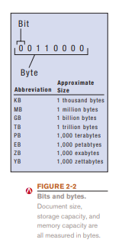
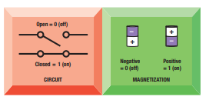
Data Representation
Concept Binary Encoding

Slide 3
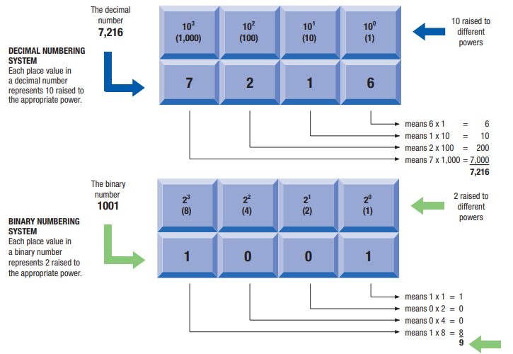

Slide 4
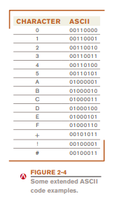
Encoding Schemes
ASCII
EBDIC
Unicode

Slide 5
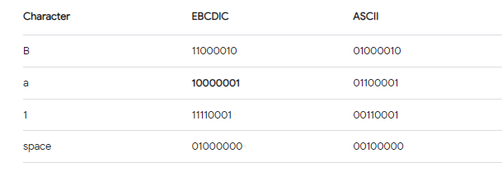
Encoding Schemes
ASCII
EBDIC
Unicode

Slide 6
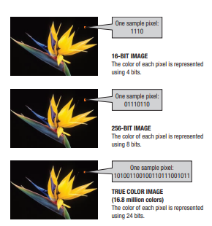
Multimedia
Representation
Pixel
Frames
Etc.
Video Representation

Slide 7
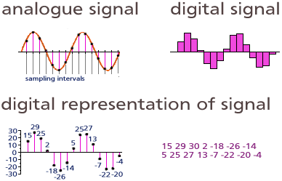
Multimedia
Representation
Samples
Intervals
Frames
Etc.
Audio Representation

Slide 8
Inside the System Unit
The Motherboard
Computer Chip
Very small pieces of silicon or other semi-conducting material onto which integrated circuits are embedded
Circuit Board
A thin board containing computer chips and other electronic components
System Board
The main circuit board inside the system unit to which all devices must connect

Slide 9
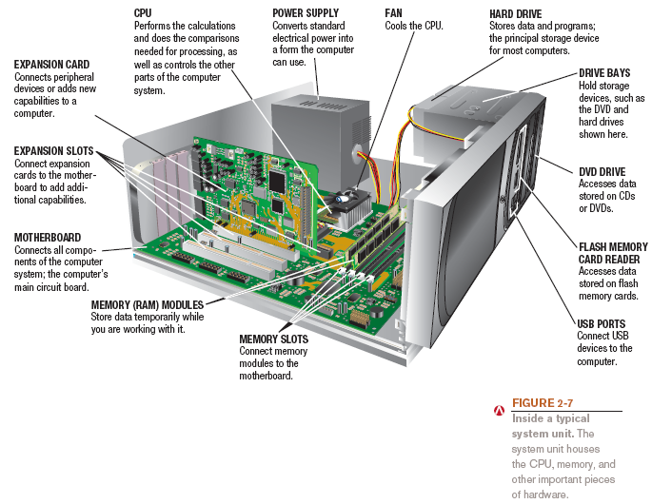
Inside System Unit

Slide 10
Inside the System Unit
External devices (monitors, keyboards, mice, printers)
Wireless devices (e.g., Bluetooth)
Power Supply
  Connects to the motherboard to deliver electricity
(personal computer)
  Portable computers use rechargeable battery pack
    Nonremovable batteries more difficult and expensive to replace

Slide 11
Inside the System Unit
Drive Bays
  Rectangular metal racks inside the system unit that house storage devices
    Hard drive, CD/DVD drive, flash memory card reader
    Connected to the motherboard with a cable

Slide 12
The CPU
Central processing unit (CPU): circuitry and components packaged together and connected directly to the motherboard
  Does the vast majority of processing for a computer
  Also called a processor; called a microprocessor when talking about personal computers
Dual-core CPU: Contains the processing components (cores) of two separate processors on a single CPU
Quad-core CPU: Contains 4 cores
Typically different CPUs for desktop computers, portable computers, servers, mobile devices, consumer devices, etc.
Often made by Intel or AMD

Slide 13
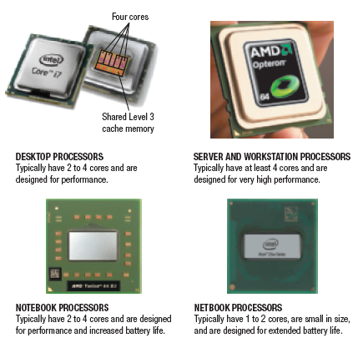
The CPU

Slide 14
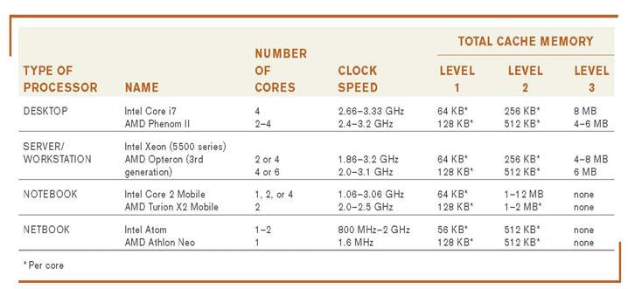
The CPU

Slide 15
Processing Speed
CPU clock speed: One measurement of processing speed
  Measured in megahertz (MHz) or gigahertz (GHz)
  Higher CPU clock speed = more instructions processed per second
Alternate measure of processing speed is the number of instructions a CPU can process per second
  Megaflops, gigaflops, teraflops
Other factors (CPU architecture, memory, bus speed, amount of RAM, etc.) also affect the overall processing speed of a computer

Slide 16
Cache Memory
Cache memory: Special group of very fast memory chips located on or close to the CPU
  Level 1 is fastest, then Level 2, then Level 3
  More cache memory typically means faster processing
  Usually internal cache (built into the CPU)
  Often some cache dedicated to each core; may also have some shared cache accessible by any core
Volatile vs Non-Volatile Memory?

Slide 17
How the CPU Works
CPU: Consists of a variety of circuitry and components packaged together
  Transistor: Key element of the microprocessor
    Made of semi-conductor material that acts like a switch controlling the flow of electrons inside a chip
Today’s CPUs contain hundreds of millions of transistors; the number doubles about every 18 months (Moore’s Law)

Slide 18
Typical CPU Components
Arithmetic/Logic Unit (ALU): Performs integer arithmetic and logical operations
Floating Point Unit (FPU): Performs decimal arithmetic
Control unit: Coordinates and controls activities
Prefetch unit: Tries to fetch data and instructions before they are needed from cache or RAM
Decode unit: Translates instructions so they are understood by the control unit, ALU, and FPU
Internal cache and registers: Store data and instructions needed by the CPU
Bus interface unit: Allows the core to communicate with other CPU components

Slide 19
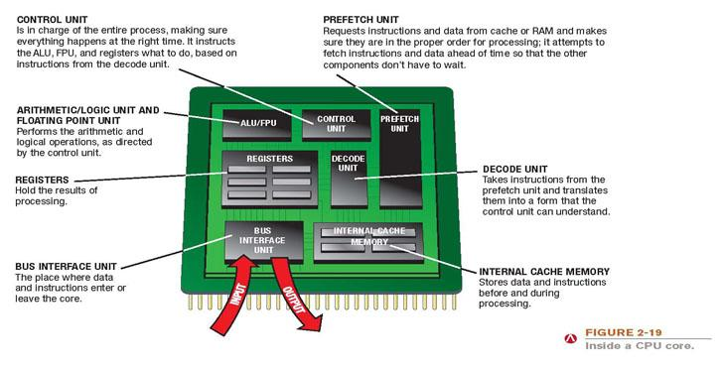
Typical CPU Components

Slide 20
The System Clock and the Machine Cycle
System Clock
  Timing mechanism within the computer system that synchronizes the computer’s operations
    Sends out a signal on a regular basis to all computer components
    Each signal is a cycle
    Number of cycles per second is measured in hertz (Hz)
    One megahertz = one million ticks of the system clock
    During each CPU clock tick, one or more pieces of microcode are processed

Slide 21
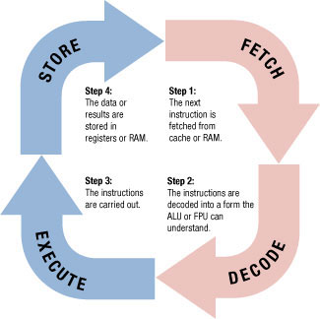
The System Clock and the Machine Cycle
Machine cycle: The series of operations involved in the execution of a single machine level instruction
  Fetch: The program instruction is fetched
  Decode: The instructions are decoded so,
  the control unit, ALU, and FPU can understand them
  Execute: The instructions are
  carried out
  Store: The original data or the
  result from the ALU or FPU
  execution is stored in the CPU’s
  registers

Slide 22
Memory
Memory
  Refers to chip-based storage located inside the system unit
  Storage refers to the amount of long-term storage available to a computer
  Random Access Memory (RAM)
    Computer’s main memory
    Consists of chips arranged on a circuit board called a memory module which are plugged into the motherboard
    Stores essential parts of operating system, programs, and data the computer is currently using

Slide 23
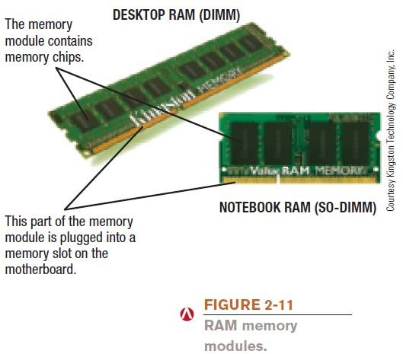
Memory

Slide 24
Memory
Volatile
  RAM content lost when the computer is shut off
  ROM and flash memory are non-volatile
Measured in bytes
  Amount installed depends on the CPU and operating system being used

Slide 25

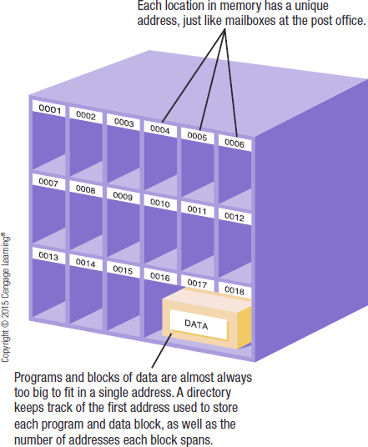
Memory
Each location in memory has an address
  Each location typically holds one byte
  Computer system sets up and maintains directory tables to facilitate retrieval of the data

Slide 26
Memory
Registers
  High-speed memory built into the CPU
  Used to store data and intermediary results during processing
  Fastest type of memory
ROM (read-only memory)
  Non-volatile chips located on the motherboard into which data or programs have been permanently stored
  Retrieved by the computer when needed
  Being replaced with flash memory

Slide 27
Memory
Flash Memory
  Nonvolatile memory chips that can be used for storage
  Have begun to replace ROM for storing system information
  Now stores firmware for personal computers and other devices
  Built into many types of devices (media tablets, mobile phones, and digital cameras) for user storage

Slide 28
Cooling Components
Fans
  Fans used on most personal computers to help cool the CPU and system unit
  Heat is an ongoing problem for CPU and computer
manufacturers
    Can damage components
    Cooler chips run faster
Heat Sinks
  Small components typically made out of aluminum with fins that help to dissipate heat

Slide 29
Expansion
Expansion Slots, Expansion Cards, and ExpressCard Modules
  Expansion Slot
    A location on the motherboard into which expansion cards are inserted
  Expansion Card
    A circuit board inserted into an expansion slot
    Used to add additional functionality or to attach a peripheral device
  ExpressCard Modules
    Designed to add additional functionality to notebooks

Slide 30
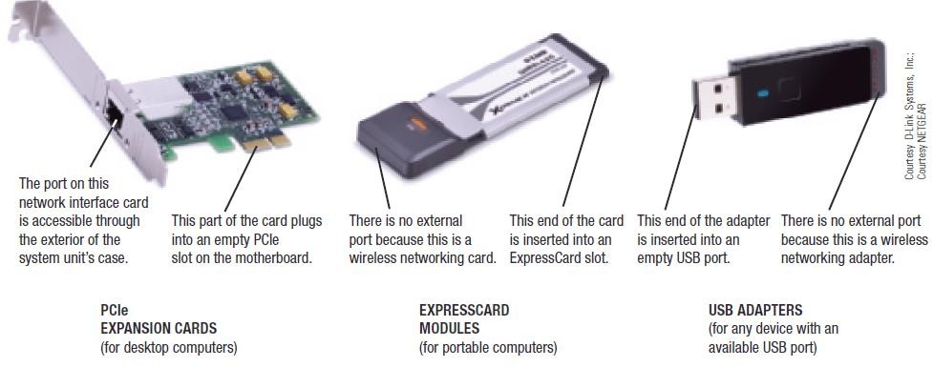

Expansion

Slide 31
Buses
Bus
  An electronic path within a computer over which data travels
    Located within the CPU and etched onto the motherboard
  Expansion Bus
    Connects the CPU to peripheral (typically input and output) devices
  Memory Bus
    Connects CPU directly to RAM
  Frontside Bus (FSB)
    Connects CPU to the chipset that connects the CPU to the rest of the bus architecture

Slide 32
Buses
Bus Width, Bus Speed, and Bandwidth
  A bus is an electronic path over which data can travel
  Found inside the CPU and on the motherboard
  Bus width is the number of wires in the bus over which data can travel
    A wider bus allows more data to be transferred at one time

Slide 33
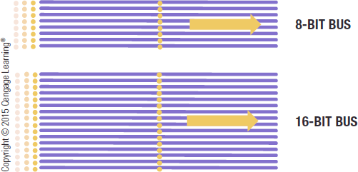
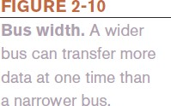
Buses
Bus width and speed determine the throughput or bandwidth of the bus
– The amount of data that can be transferred by the bus in a given time period

Slide 34
Buses
PCI and PCI Express (PCIe) Bus
  PCI has been one of the most common types
  Today, PCI Express bus, which is extremely fast, has replaced the PCI bus
Universal Serial Bus (USB)
  Extremely versatile
  Allows 127 different devices to connect to a computer via a single USB port
FireWire Bus
  Developed by Apple to connect multimedia devices to a computer

Slide 35
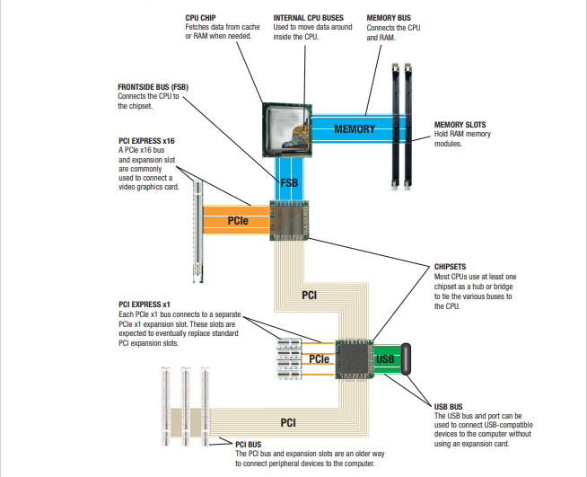

Slide 36
Ports and Connectors
Port
  A connector on the exterior of a computer’s system unit to which a device may be attached
  Typical desktop computer ports include:
    Power connector, Firewire, VGA monitor, Network, USB, Audio, and HDMI
  Others include IrDA and Bluetooth ports, eSATA ports, Thunderbolt ports (Apple devices)
  Most computers support the Plug and Play standard

Slide 37
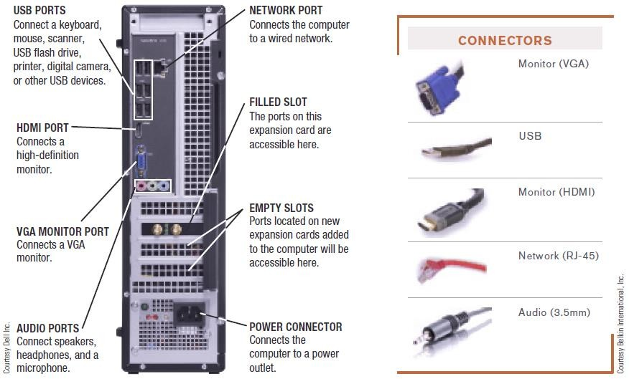
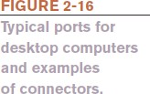
Ports and Connectors

Slide 38
Ports and Connectors
Portable computers have ports similar to desktop computers, but often not as many
Smartphones and mobile devices have more limited expansion capabilities
  Usually have a USB port, HDMI port, and/or flash memory card slot
  Flash memory cards often use the Secure Digital (SD) format
  MiniSD and microSD cars are smaller than regular SD cards

Slide 39
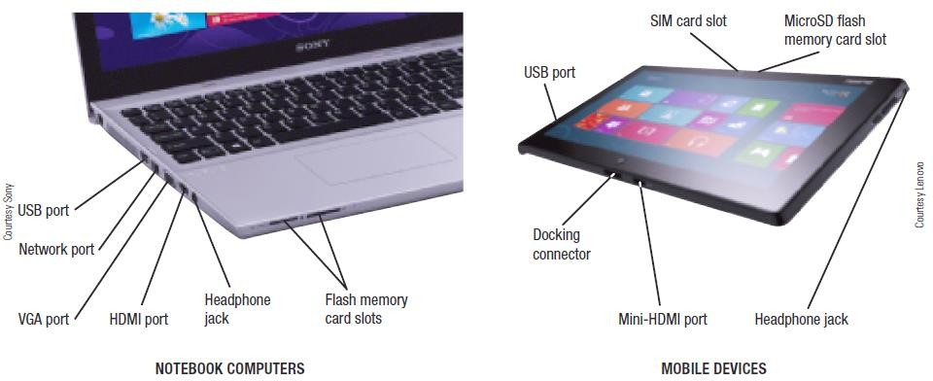

Ports and Connectors

Slide 40
Making Computers Faster and Better
Improving performance today
  Add more memory
  Perform system maintenance
    Uninstall programs properly
    Consider placing large files on external storage devices
    Delete temporary files
    Error check and defragment
    Scan for viruses and spyware
    Clean out dust once or twice a year
  Buy a larger or second hard drive
  Upgrade your Internet connection
  Upgrade your video graphics card

Slide 41
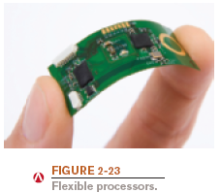
Making Computers Faster and Better
Strategies for faster and better computers
  Improved architecture: Smaller components, faster bus speeds, multiple CPU cores, etc.
  Improved materials: New backing materials, flexible circuits, etc.
  Pipelining: Allows multiple instructions to be processed at one time
  Multiprocessing and parallel processing: Use multiple processors to speed up processing

Slide 42
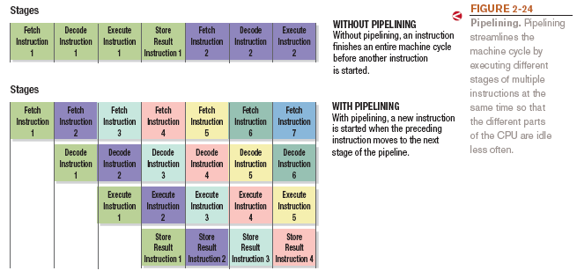
Pipelining

